Slide 1
Unit VI – DS Applications
PART 2 PPT (Self Study)

Slide 2
Unit-VI Applications
Use of binary tree in expression tree-evaluation and Huffman's coding,
Data structure used in social networking and Google map,
Applications of heap, Symbol Table,
Applications of Hash Tables, and Files

Slide 3
Use of binary tree in expression tree-evaluation and Huffman's coding

Slide 4
Applications of Binary Tree : Trie, Merkle Tree

Slide 5
Merkle Tree
A Merkle tree is a hash-based data structure that is a generalization of the hash list. It is a tree structure in which each leaf node is a hash of a block of data, and each non-leaf node is a hash of its children. Typically, Merkle trees have a branching factor of 2, meaning that each node has up to 2 children
Merkle trees are used in distributed systems for efficient data verification. They are efficient because they use hashes instead of full files. Hashes are ways of encoding files that are much smaller than the actual file itself. Currently, their main uses are in peer-to-peer networks such as Tor, Bitcoin, and Git

Slide 6
Bitcoin is a popular online, anonymous currency. All transactions in bitcoin are stored in blocks on what is called the blockchain. This blockchain exists on every bitcoin user's computer. Leaves of the Merkle tree used in bitcoin are typically hashes of single blocks. Every time someone wants to alter the blockchain (for example by adding transactions), this change needs to be reflected everywhere.
Merkle trees can be used to check for inconsitencies in more than just files and basic data structures like the blockchain. Apache Cassandra and other NoSQL systems use Merkle trees to detect inconsistencies between replicas of entire databases. Imagine a website that people use all over the world. That website probably needs databases and servers all over the world so that load times are good. If one of those databases gets altered, then every single other database needs to be altered in the same way. Hashes can be made of chunks of the databases, and Merkle trees can detect inconsistencies
Git is a popular version control system mainly used by programmers. All of the saved files are saved on every user's computer at all times. So, it's very important to check that these changes are consistent across everyone's computer.

Slide 7
Data structure used in social networking and Google map : Dijkstra’s Algorithm - Single Source Shortest Path

Slide 8
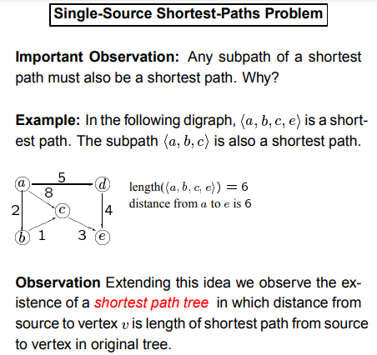

Slide 9
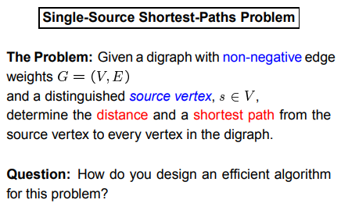

Slide 10
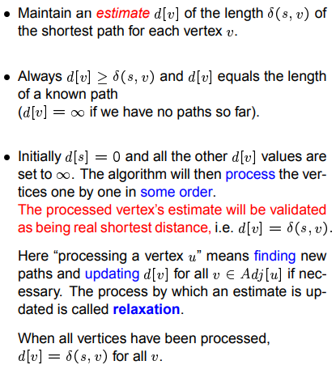
Idea behind Dijkstra’s Algo

Slide 11
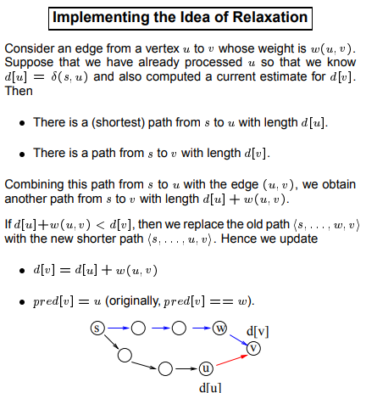

Slide 12
Application of Heap Data Structure

Slide 13
Heap Data Structure
Heap data structure can be used to implement a priority queue.
A heap data structure should not be confused with the heap, a pool of memory used for dynamic memory allocation.
A common implementation of a heap is the binary heap, which is defined as a binary tree with two additional properties:
Structural property: A binary heap is a complete binary tree, i.e., all levels of the tree, except possibly the last one (deepest) are fully filled, and, if the last level of the tree is not complete, the nodes of that level are filled from left to right.
Heap Property: The key stored in each node is either “greater than or equal to” or “less than or equal to” the keys in the node’s children.

Slide 14
Applications of Heap DS
Heaps are crucial in several efficient graph algorithms, such as Dijkstra’s shortest path algorithm and Prim’s algorithm for minimum spanning tree.
They are also used in the Heapsort sorting algorithm

Slide 15
Application of Heap DS : Heap Sort

Slide 16
Application of Heap: Heap Sort
STEPS: Create a Max Heap (for ascending order sort). Once the heap is created, swap the root note with the last node and delete the previous node from the heap. Continue till last remaining node.
Time complexity : O(nlogn)
Advantage: Low memory usage, optimized and generally efficient
Disadvantage: Unstable, expensive, and not very efficient when working with highly complex data

Slide 17
void heap_sort(int Arr[ ])
{ int heap_size = N;
build_maxheap(Arr);
for(int i = N; i>=2 ; i-- )
{
swap(Arr[0], Arr[ i ]);
heap_size = heap_size-1;
max_heapify(Arr, 0, heap_size);
} }

Slide 18
Application of Heap DS : Priority Queue

Slide 19
Priority Queue
An ADT (Abstract Data Type) for maintaining a set S of elements, with each element having a “priority” associated with it.
An element with high priority is served before an element with low priority and vice versa.
f two elements have the same priority, they are served according to their order in the queue.
Supports the following operations:
push(x): inserts an element x in set S – usually an O(log(n)) operation.
top() or peek(): returns the element of S with highest (or lowest) priority (but does not modify the queue) – O(1) operation.
pop(): returns and removes the element of S with highest (or lowest) priority – usually an O(log(n)) operation.

